Slide 1
Tender Status as per 2nd RDPP of HFMLIP
Sl. No. | Tender Status as per 2nd RDPP | Remarks
1 | 47 Packages already Tender and work is on going.
2 | Remaining 9 Packages are to be tendered the F/Y (2020-21) works: 1 No. Submersible Embankment Protection for Dharmapasha Rui Beel at Sunamgonj. 6 Nos. Submersible Embankment Protection for Naogaon, Nunnir, Noapara, Dakshiner Haor at Kishoregonj. 1 no. Threshing floor. 1 no. Gate Replacement for Satdona & Chahal Beel Sub-Project.
Total 55 Nos. and 1 no. O&M during construction.

Slide 3
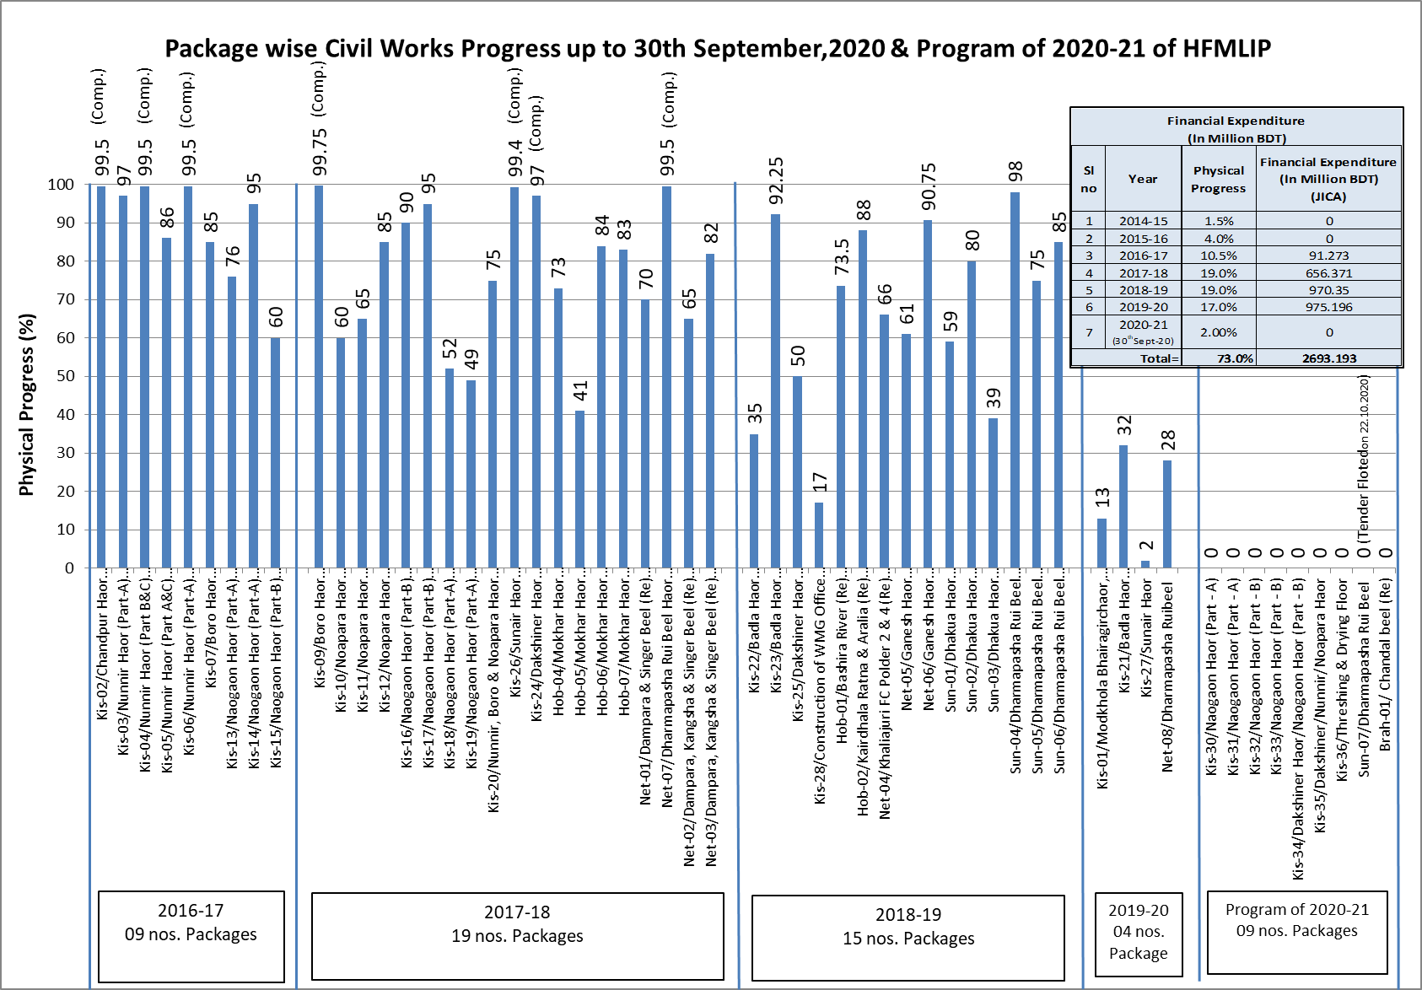

Slide 4
Financial Expenditure (In Million BDT)
Sl no | Financial Year | Physical Progress | GOB | Project Aid (PA) |  |  |  | Total | Cumulative expenditure (in Million BDT)
 |  |  |  | RPA |  | Total RPA | DPA For Consultant
 |  |  |  | Civil Works | Livelihood
1 | 2 | 3 | 4 | 5 | 6 | 7 | 8 | 4+5+6+7
1 | 2014-15 | 1.5% | 60.662 | 0.0000 | 0.00 | 0.00 | 84.96 | 145.6 | 145.6
2 | 2015-16 | 4.0% | 82.428 | 0.0000 | 0.92 | 0.92 | 184.94 | 268.3 | 413.9
3 | 2016-17 | 10.5% | 555.849 | 91.2730 | 34.91 | 126.18 | 109.32 | 791.3 | 1205.3
4 | 2017-18 | 19.0% | 782.197 | 656.3710 | 78.98 | 735.35 | 68.93 | 1586.5 | 2791.7
5 | 2018-19 | 19.0% | 631.334 | 970.3530 | 93.99 | 1064.35 | 68.64 | 1764.3 | 4556.1
6 | 2019-20 | 17.0% | 312.082 | 975.1960 | 39.82 | 1015.01 | 45.00 | 1372.1 | 5928.2
7 | 2020-21 (30thSept-20) | 2.0% | 9.948 | 0.0000 | 0.00 | 0.00 | 0.00 | 9.948 | 5938.1
Total |  | 73.0% | 2434.5 | 2693.2 | 248.6 | 2941.8 | 561.8 | 5938.1

Slide 5
Protection Type (Type A)

Slide 6
Protection Type (Type B)

Slide 7
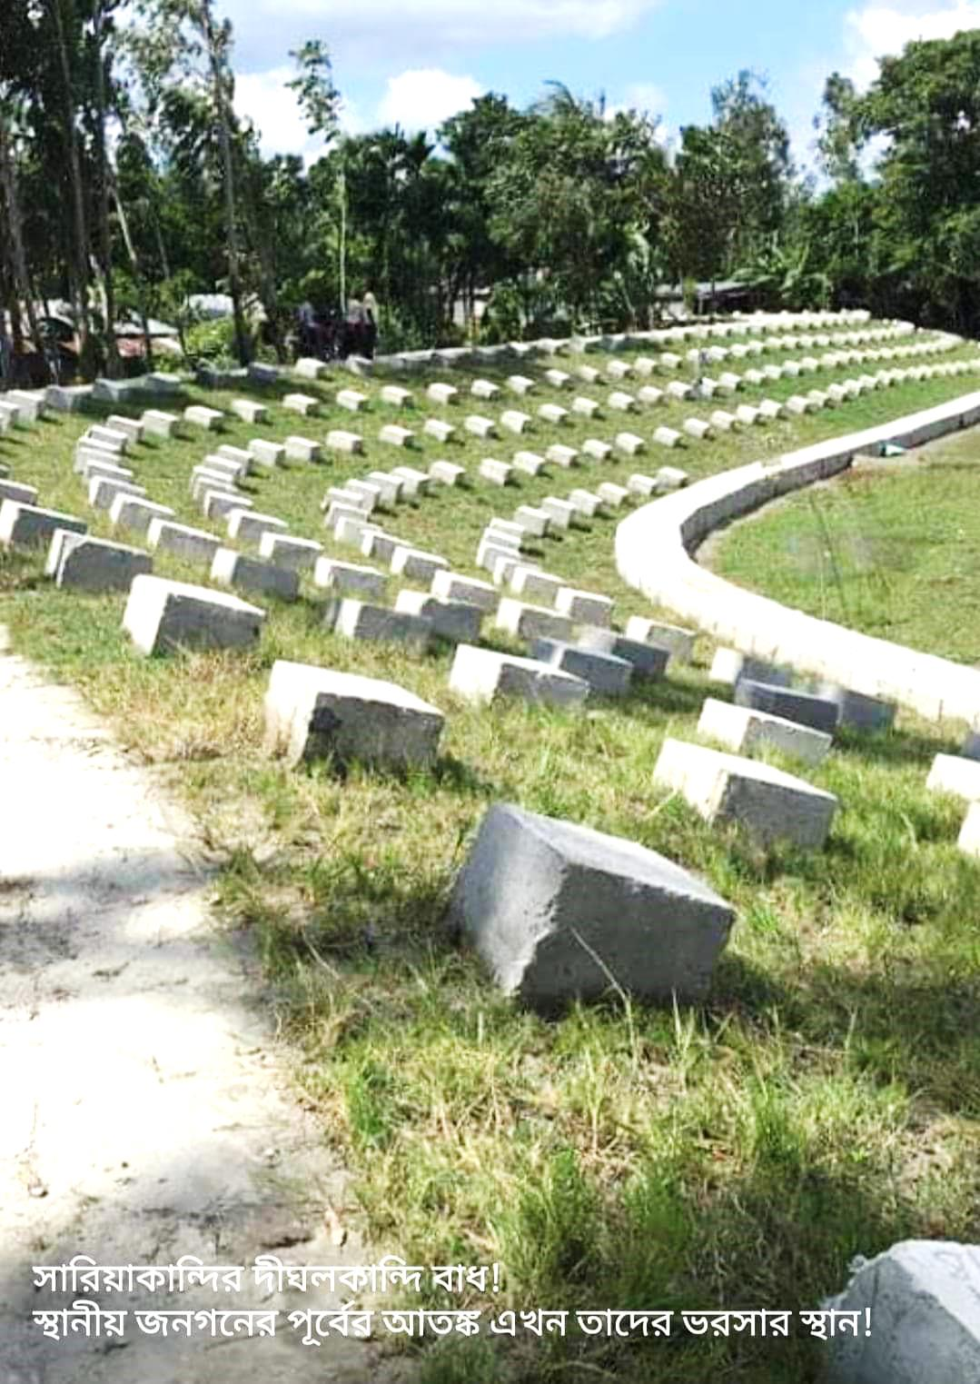
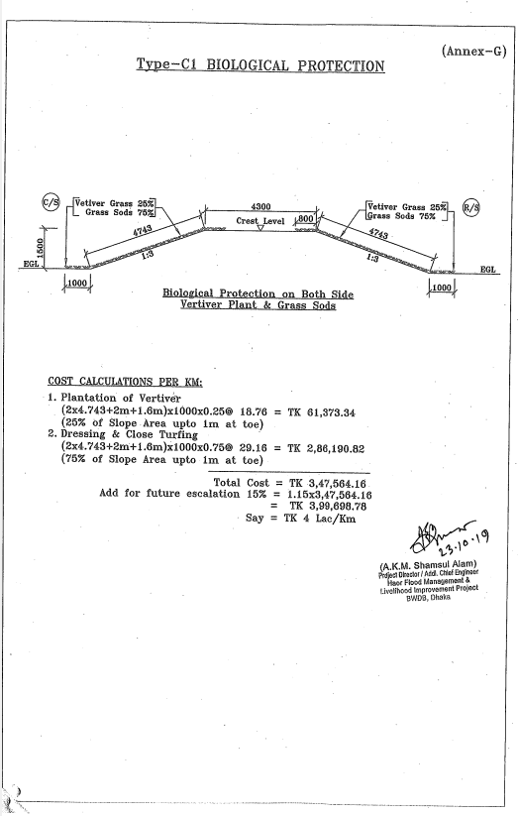
Biological Protection

Slide 8
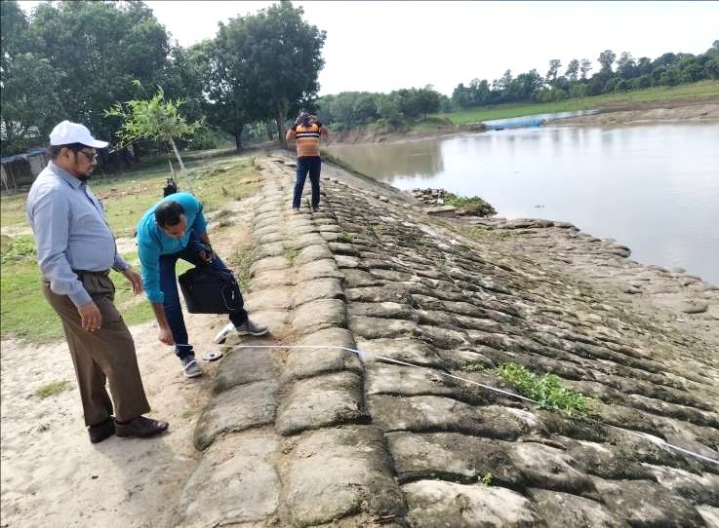
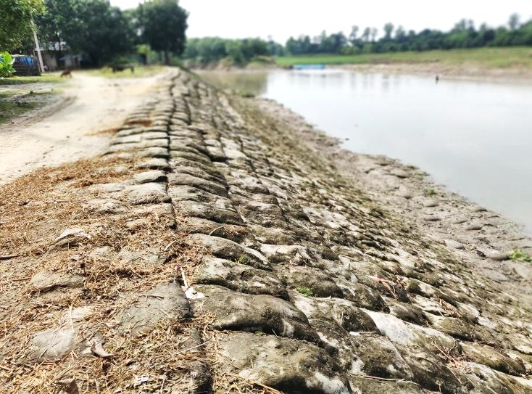
Protection Type (Type D)
River Bank Protective Work in Pagla & Mohanondha River with Sand-Cement & Gunny Bag (1:6)

Slide 9
Protection Type (Flood Fuse)

Slide 10
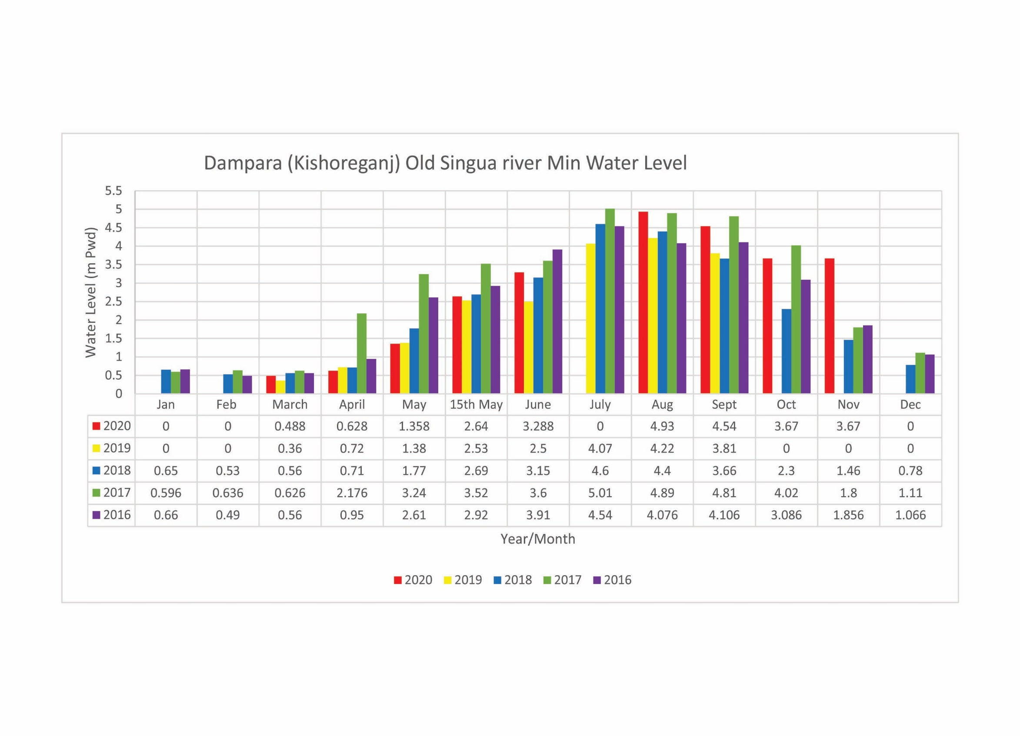

Slide 11
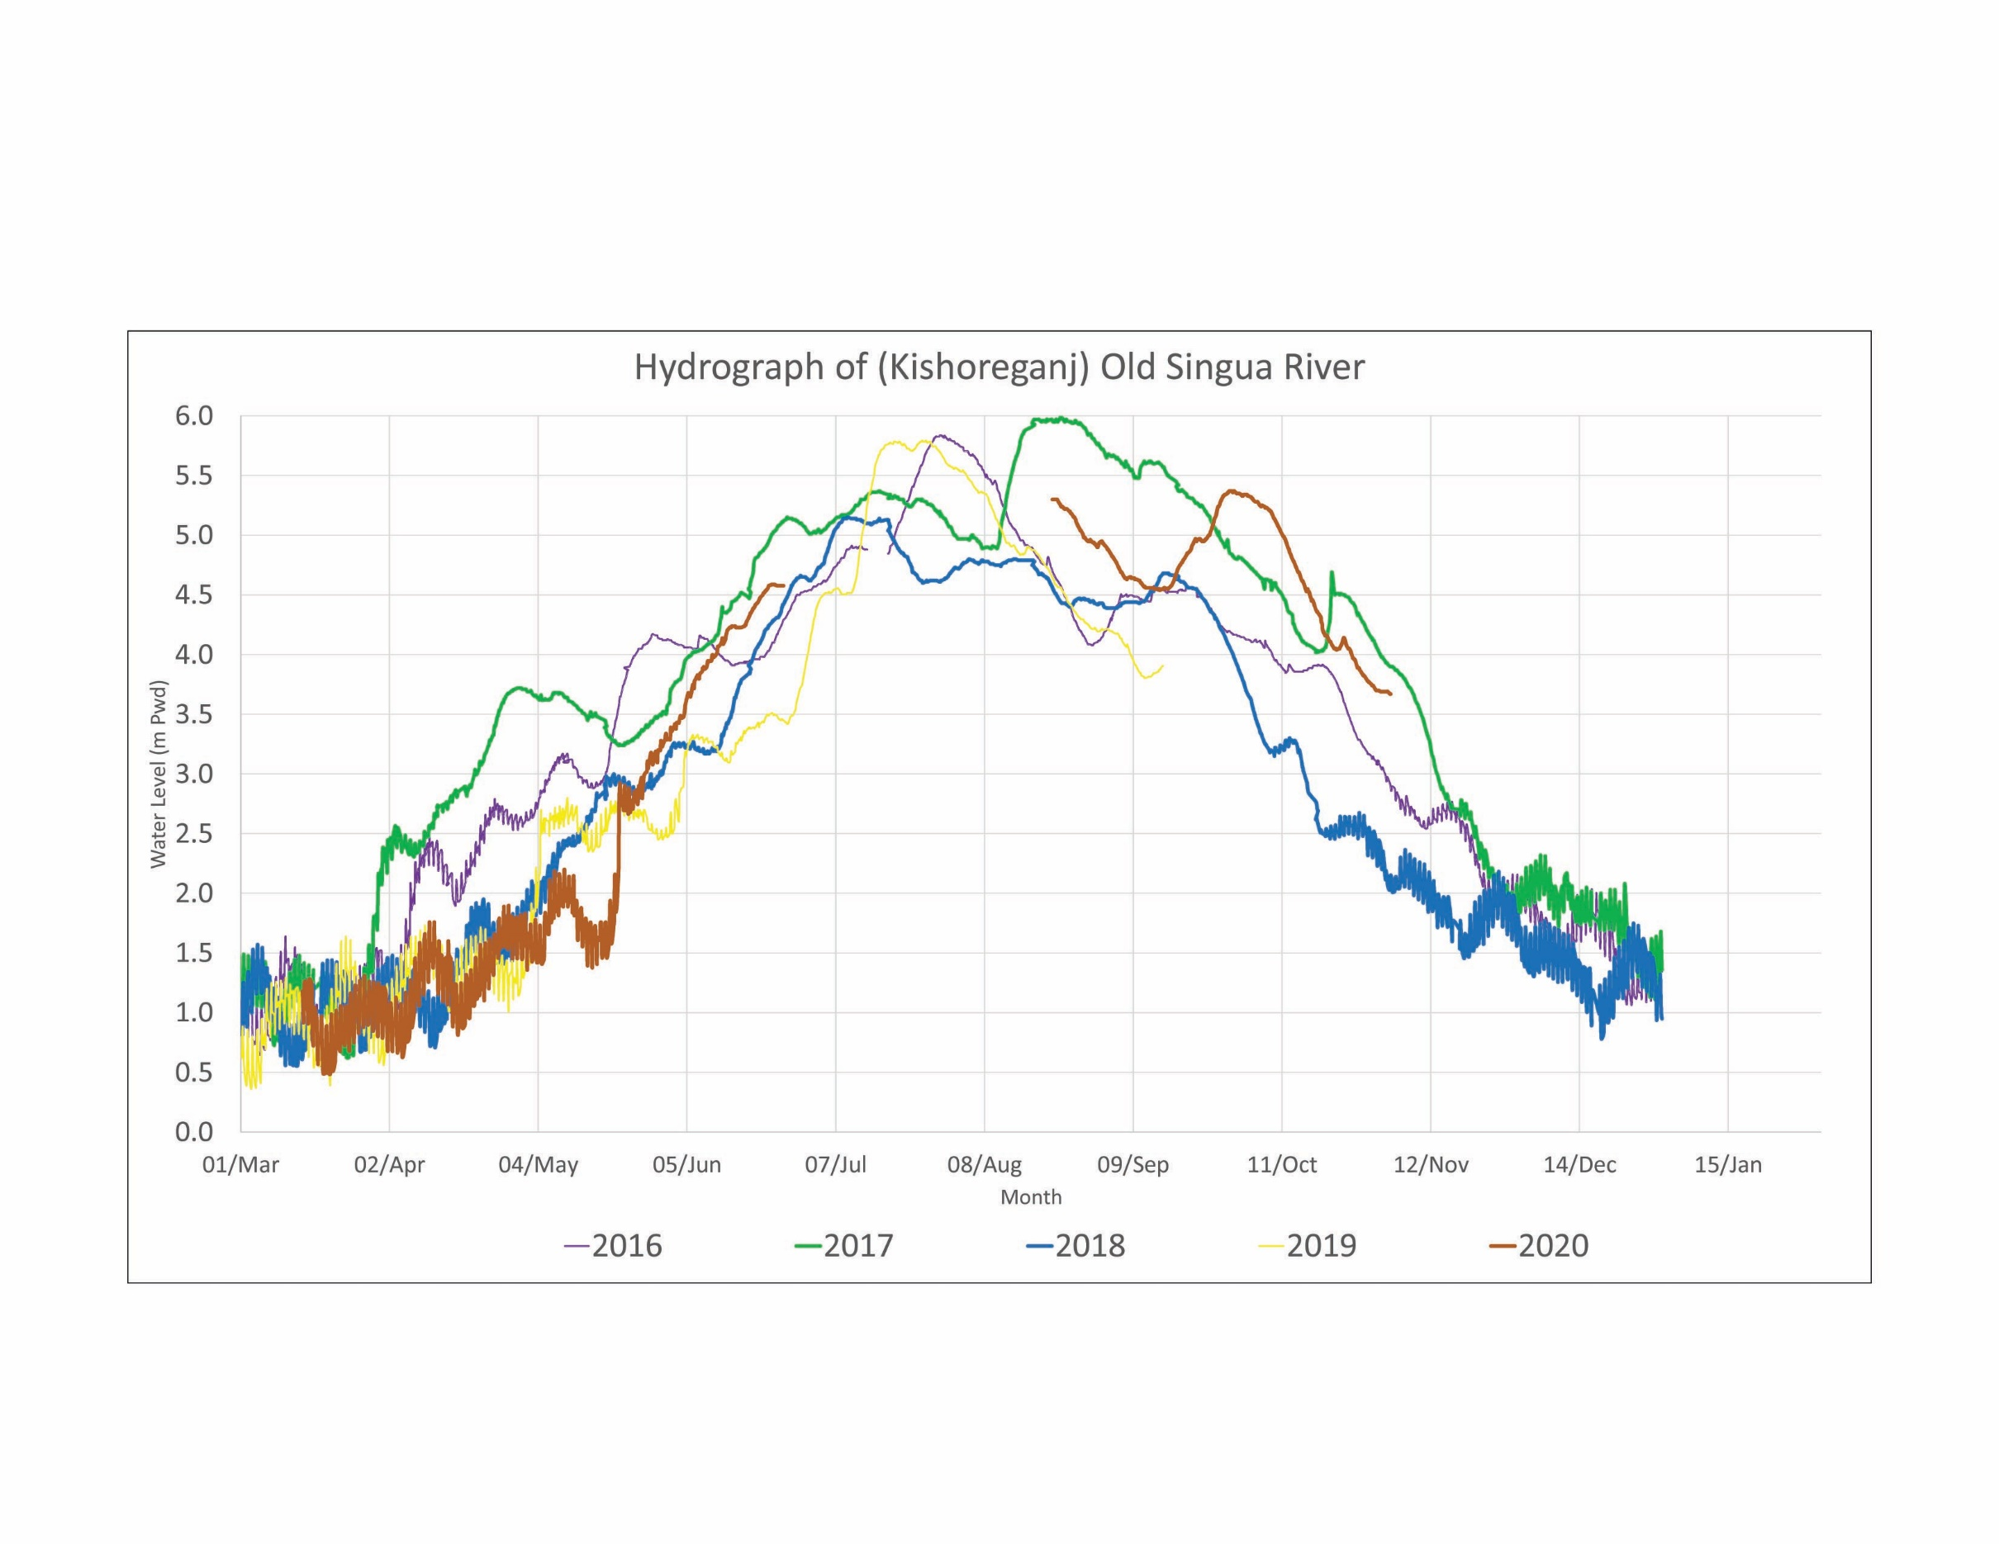

Slide 12
